Slide 1

Data Augmentation for Medical Images: Chest X-Ray Images (Pneumonia)
Team Members:
Shashvat Jain 21ucs189
Shreyanshu Raj 21ucs199
Shreyas Acharya 21ucs200
Sourankit Giri 21ucs207
Submitted to:
Dr. Ankit Jha

Slide 2
Problem Statement
Medical imaging datasets, especially labeled chest X-ray images for pneumonia detection, are limited.
This scarcity of data leads to challenges in training deep learning models:
Overfitting: models memorize training data but fail to generalize to unseen examples.
Poor Model Performance: Inadequate diversity in the dataset affects accuracy and robustness.
Need for advanced augmentation techniques to address data limitations effectively.

Slide 3
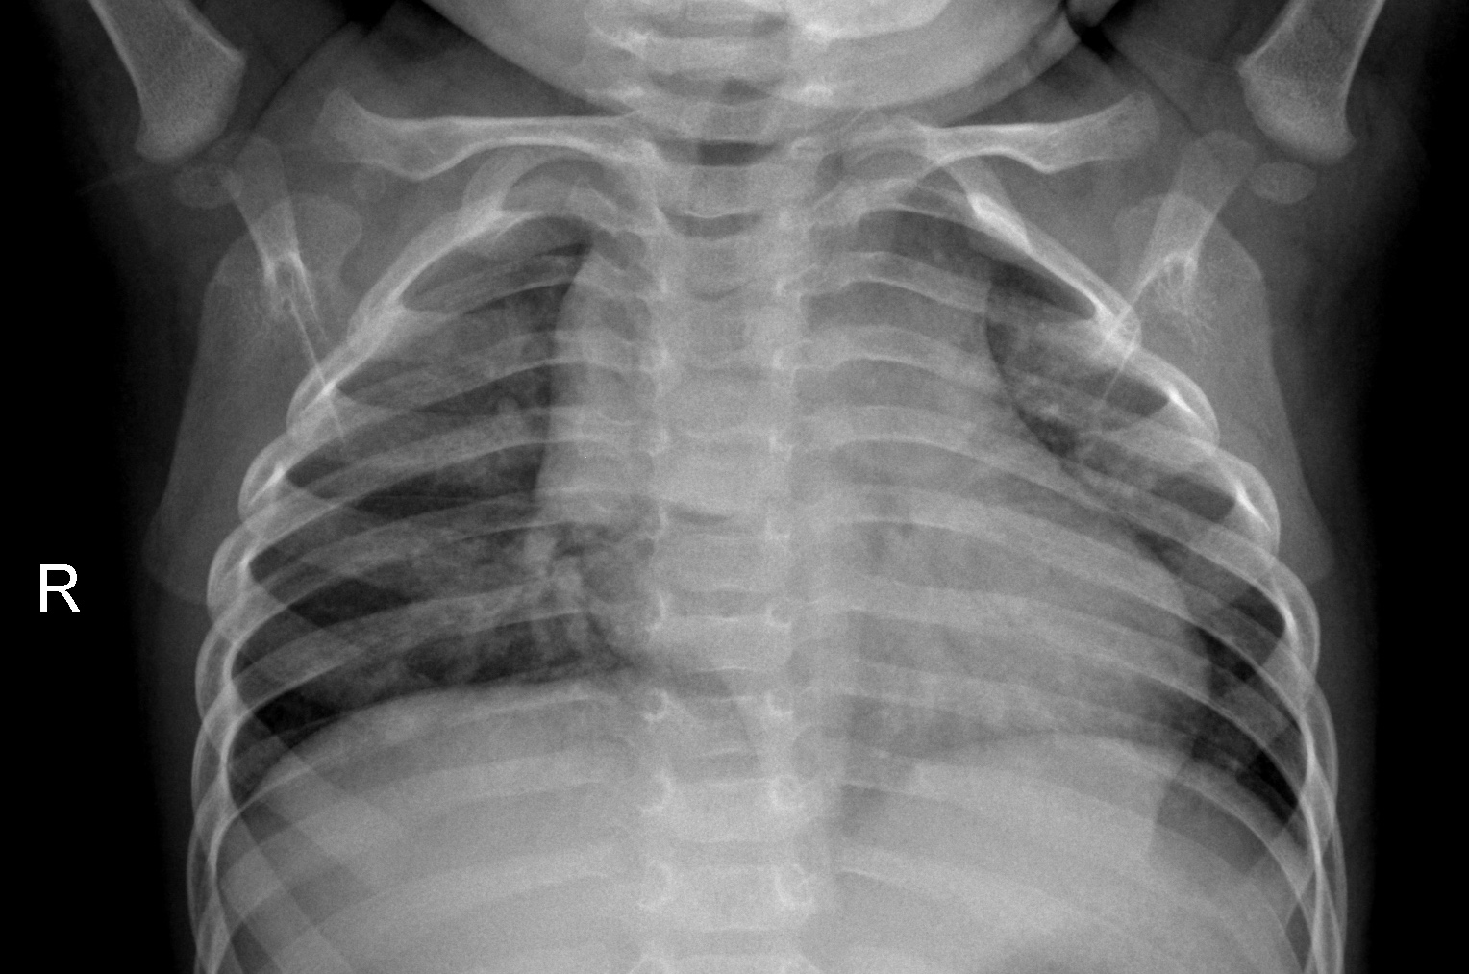
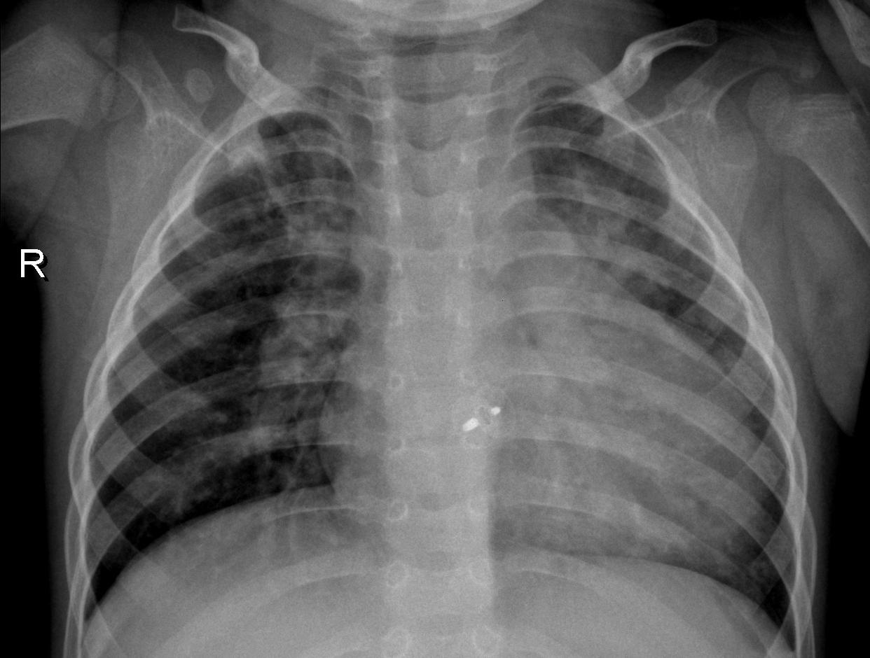
Dataset
Source: Kaggle's Chest X-Ray Images (Pneumonia) dataset.
Contains labeled X-ray images categorized as:
Normal
Pneumonia
Dataset Size:
Total images: Approximately 5,863
Distribution:
Training set: 70%
Validation set: 15%
Test set: 15%

Slide 4
Preprocessing
Data Cleaning:
Removed low-quality and corrupt images.
Normalization:
Scaled pixel values to [-1, 1] for consistent input to the model.
Image Resizing:
Standardized image dimensions to 128 x 128 pixels to reduce computational complexity.

Slide 5
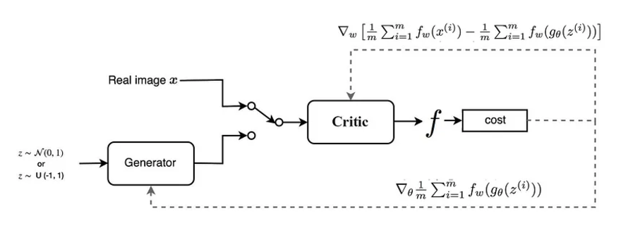
Methodology
Deep Convolutional WGAN (WGAN-GP):
Wasserstein GAN with Gradient Penalty (WGAN-GP):
A modified version of GANs, designed to reduce the instability of traditional GANs.
Generator:
Generates augmented chest X-ray images based on real images from the dataset.
Critic:
Evaluates the generated images based on their similarity to real images.

Slide 6
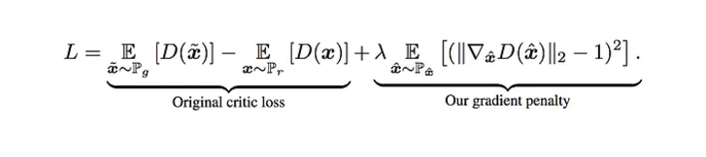
Methodology
Gradient penalty
A differentiable function f is 1-lipschitz if and only if it has gradients with norm at most 1 everywhere.
Instead of applying clipping, WGAN-GP penalizes the model if the gradient norm moves away from its target norm.

Slide 7
Hyperparameters
Batch Size: 32
Learning Rate: 0.0001
Image Size : 128
Training Epochs: 150
Lambda (for Gradient Penalty): 10.
Critic Updates per Generator Update: 5 (Critic is updated 5 times per Generator update).
Noise Dimension (Z): 100 (used as input for the generator).
Examples To Generate : 500 / 1000

Slide 8
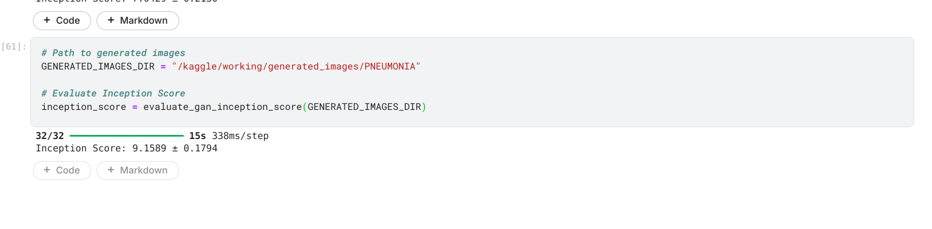
Results
For PNEUMONIA Class, Inception Score = 9.15 +- 0.18

Slide 9
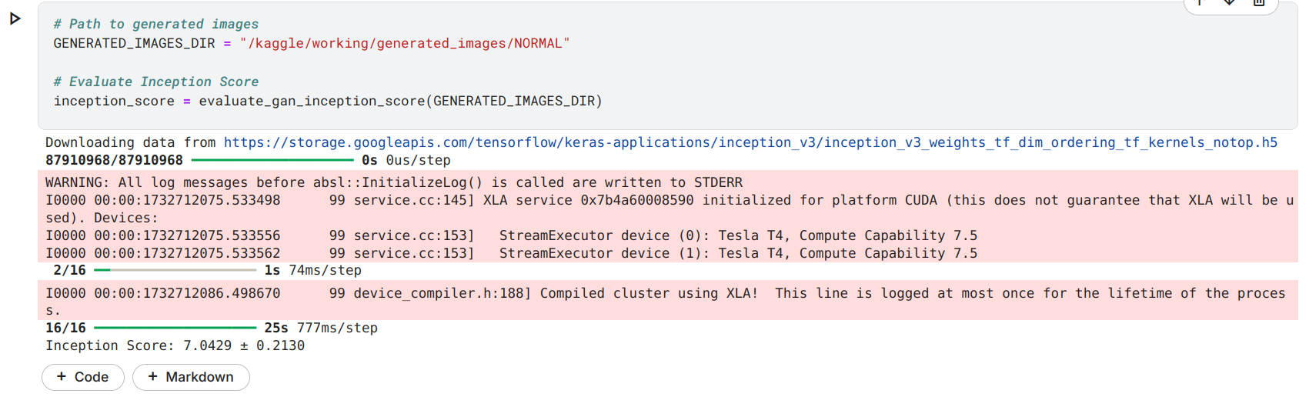
Results
For NORMAL Class, Inception Score = 7.04 +- 0.21

Slide 10
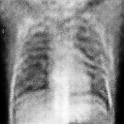
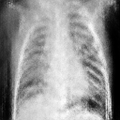
Sample Images Created
Normal
Pneumonia

